Slide 1

SCSA1304
ADVANCED DATA STRUCTURES
B.E CSE 2019-2023
III SEMESTER
VIRTUAL CLASS ROOM

Slide 2
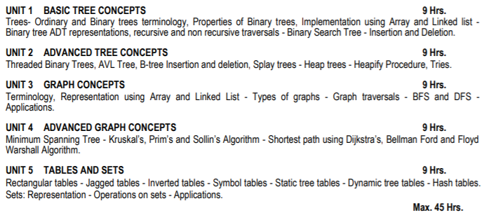

SCSA1304
ADVANCED DATA STRUCTURES

Slide 3
Terminology
Weight of an edge: It is the value of the edge or the cost of the edge.
Network: A graph with weighted edges
Spanning Tree: Any tree consisting of edges in the graph G and including all vertices in G is called a spanning tree.
Minimum Spanning Tree
Connect all the nodes in the graph with minimum number of edges, such that the total weight is minimized.
Devise an algorithm that converts a network into tree structures

Slide 4
Minimum Spanning Tree
Given a network, the edges for the minimum spanning tree are chosen in such a way that:
Every node in the network must be included in the spanning tree.
The overall edge weight of the spanning tree is the minimum possible that will allow the existence of a path between any 2 nodes in the tree.
A graph can have many spanning trees. A complete graph with n vertices has n^{(n-2)} spanning trees. So, the complete graph with 4 vertices has 4 ⁽⁴⁻²⁾ = 16 spanning trees.

Slide 5
Minimum cost of Spanning Tree
Graph is represented as set of (V,E)
Where,
V = 1,2,3,4,5,6
E={(1,2), (2,3), (3,4), (4,5), (6,1),(5,6)}
Spanning tree is a subset of a graph (Subset of edges) (All Vertices)
It should not contain cycle
|V| = N = 6
N-1 = 5 (Edges)
1
2
6
3
5
S = (V’, E’)
V’ = V
|E’| = |V| - 1
4
1
1
1
1
2
6
2
6
2
6
2
6
3
5
3
5
3
5
3
5
4
4
4
4

Slide 6
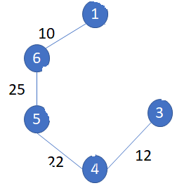
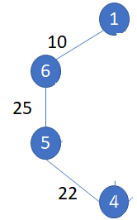
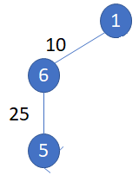
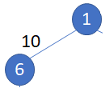
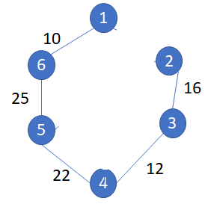
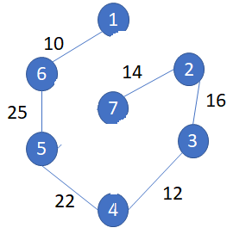
1
28
10
Solution for finding Minimum cost spanning tree
6
14
2
24
7
16
Prim’s
Kruskal’s
Sollin’s
25
5
18
3
22
12
4
Prim’s (Connected Smallest Graph)
In computer science, Prim's algorithm is a greedy algorithm that finds a minimum spanning tree for a weighted undirected graph. This means it finds a subset of the edges that forms a tree that includes every vertex, where the total weight of all the edges in the tree is minimized

Slide 7
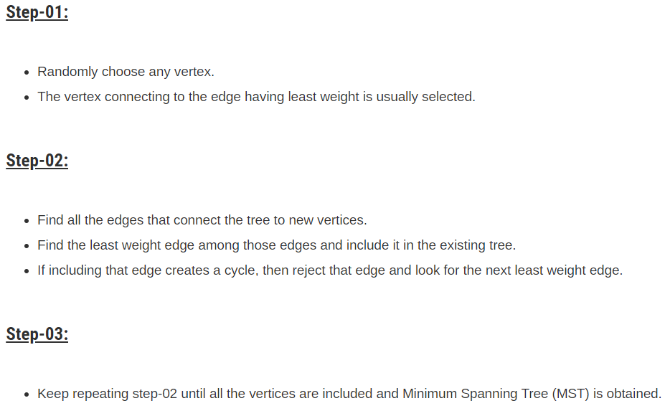

Slide 8
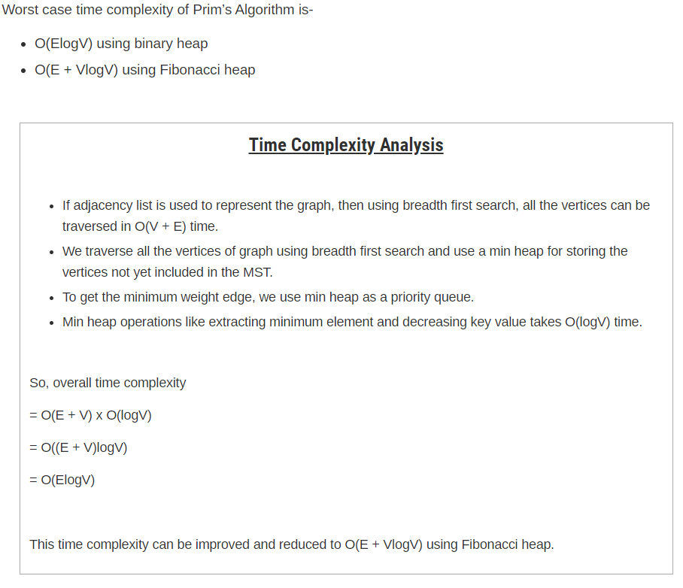

Slide 9
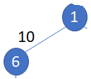
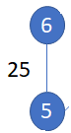
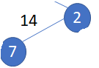
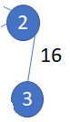
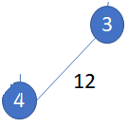
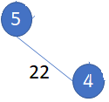
Solution for finding Minimum cost spanning tree
Kruskal’s Method (Should not form a cycle)
1
28
10
Kruskal's algorithm finds a minimum spanning forest of an undirected edge-weighted graph. If the graph is connected, it finds a minimum spanning tree. It is a greedy algorithm in graph theory as in each step it adds the next lowest-weight edge that will not form a cycle to the minimum spanning forest
6
14
2
24
7
16
25
5
18
3
22
12
4

Slide 10

Minimum Spanning Tree – Kruskal’s Method
1
6
A
D
E
Set - 1:
{A}
{B}
{C}
{D}
{E}
{F}
1 | 1 | 1 | 2 | 3 | 3 | 4 | 5 | 6
3
3
1
5
2
AD – 1
BC – 1
CD – 1
EF – 2
BD – 3
AB – 3
CF – 4
CE – 5
DE - 6
B
C
F
1
4
Disjoint set:
Make set
Find set
Union
Set – 2:
{A,D}

Slide 11

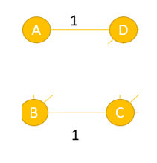
1 | 1 | 1 | 2 | 3 | 3 | 4 | 5 | 6
AD – 1
BC – 1
CD – 1
EF – 2
BD – 3
AB – 3
CF – 4
CE – 5
DE - 6
Set – 2:
{A,D}
{B,C}
1 | 1 | 1 | 2 | 3 | 3 | 4 | 5 | 6
AD – 1
BC – 1
CD – 1
EF – 2
BD – 3
AB – 3
CF – 4
CE – 5
DE - 6
Set – 2:
{A,D}+{B,C} = {A,D,B,C}
1

Slide 12

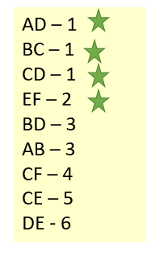
1 | 1 | 1 | 2 | 3 | 3 | 4 | 5 | 6
AD – 1
BC – 1
CD – 1
EF – 2
BD – 3
AB – 3
CF – 4
CE – 5
DE - 6
Set – 2:
{A,D,B,C}
{E} + {F} = {E,F}
1
1 | 1 | 1 | 2 | 3 | 3 | 4 | 5 | 6
Set – 2:
{A,D,B,C}
{E,F}
1

Slide 13
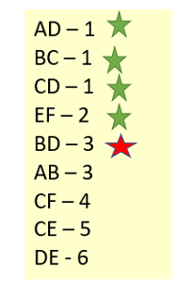
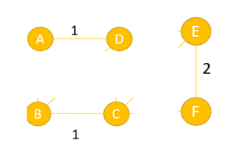
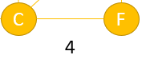
1 | 1 | 1 | 2 | 3 | 3 | 4 | 5 | 6
Set – 2:
{A,D,B,C}
{E,F}
1
1 | 1 | 1 | 2 | 3 | 3 | 4 | 5 | 6
Set – 2:
{A,D,B,C} + {E,F} = {A,D,B,C,E,F}
1

Slide 14
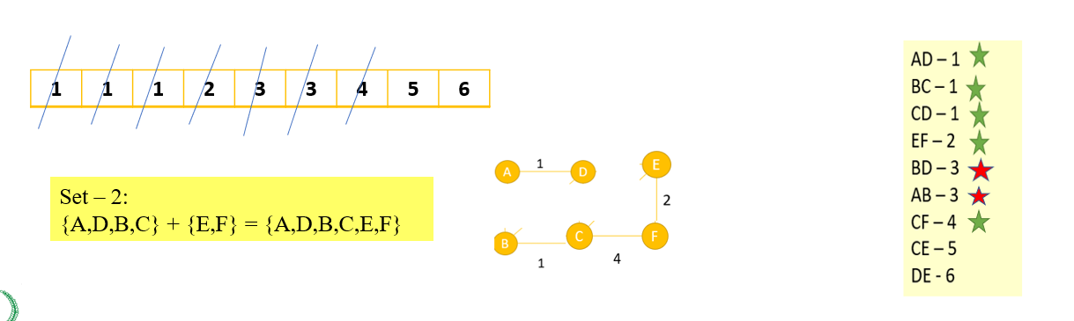
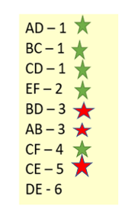
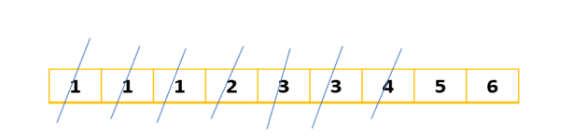
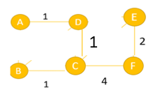
1
Set – 2:
{A,D,B,C,E,F}

Slide 15
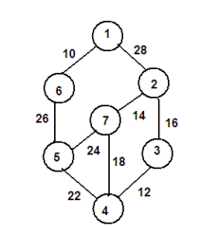
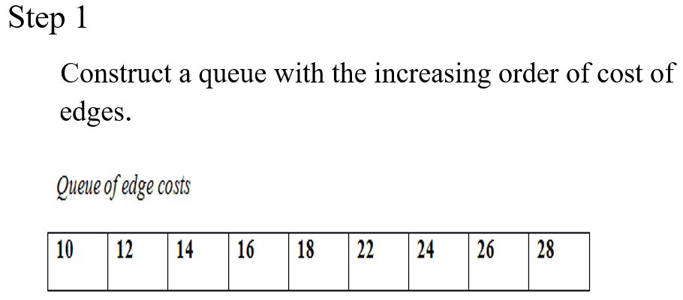
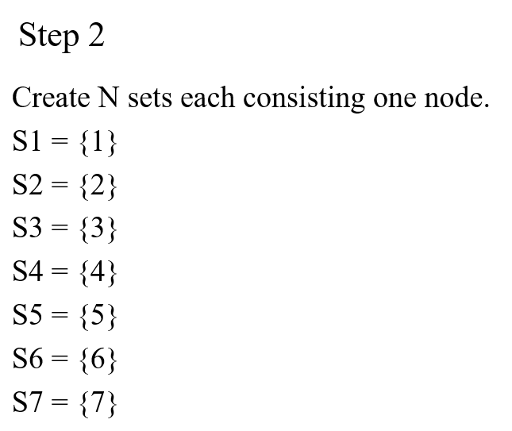
Kruskal’s Method

Slide 16
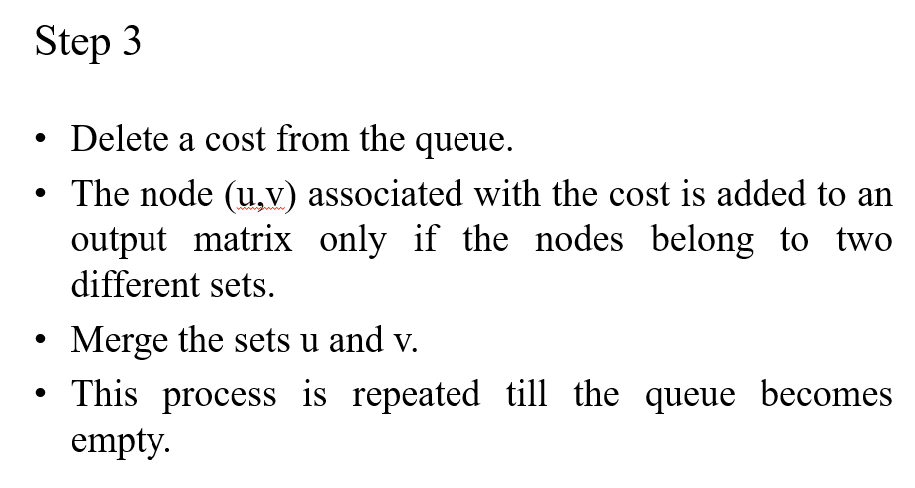
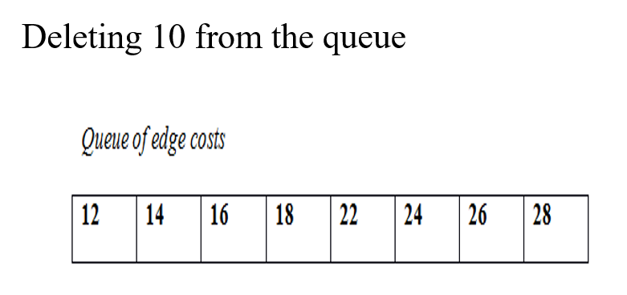

Slide 17
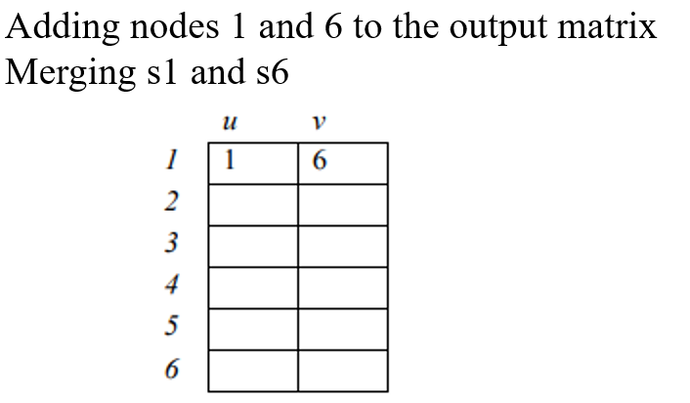
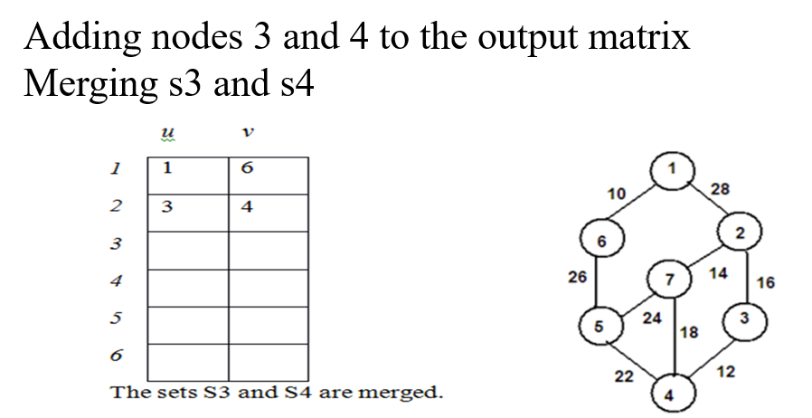
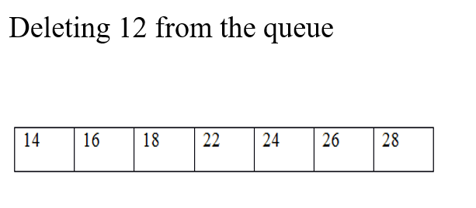
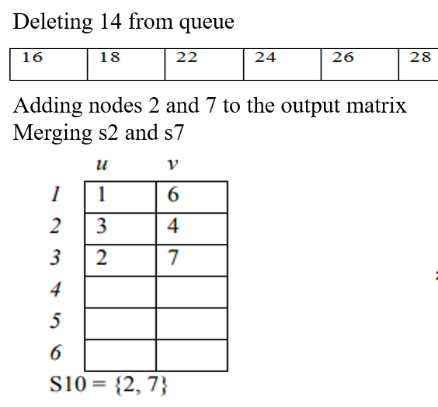

Slide 18
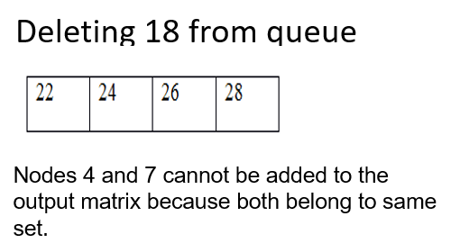
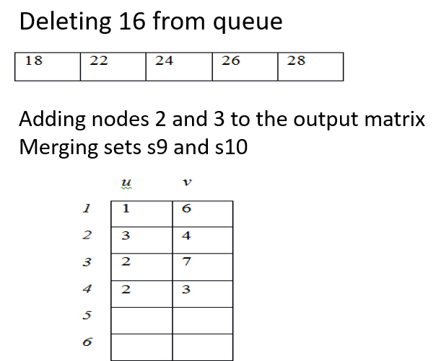
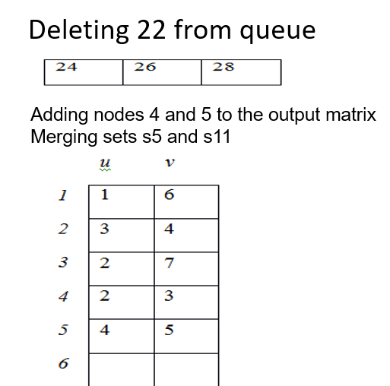

Slide 19
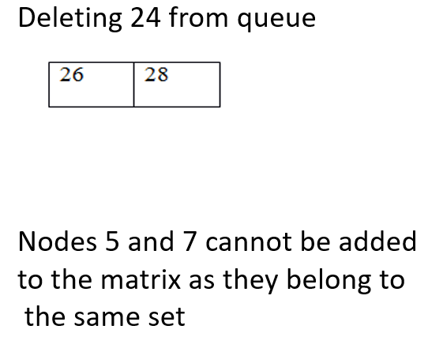
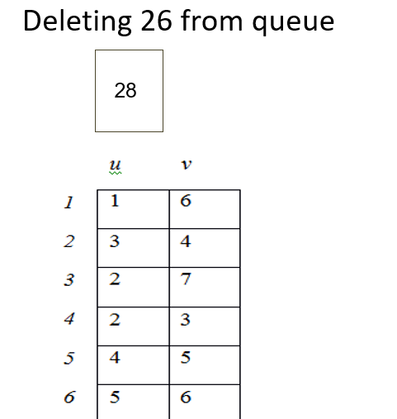
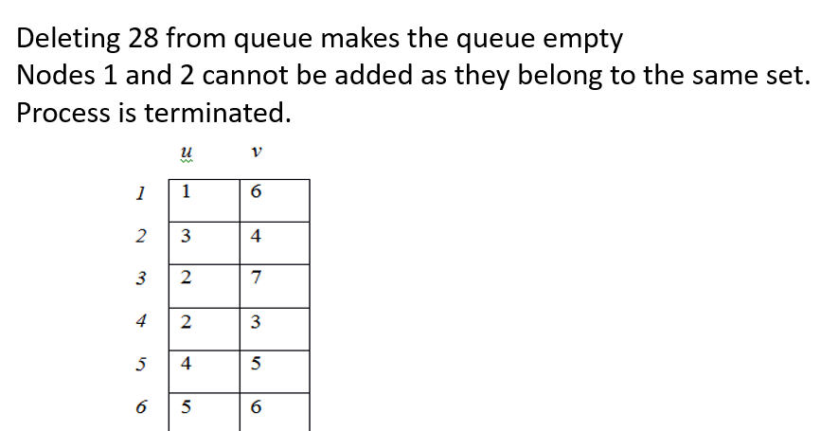

Slide 20
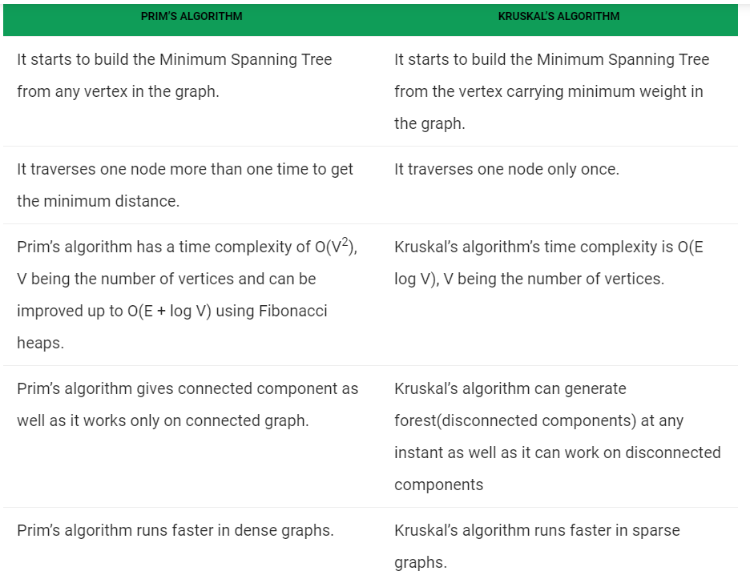
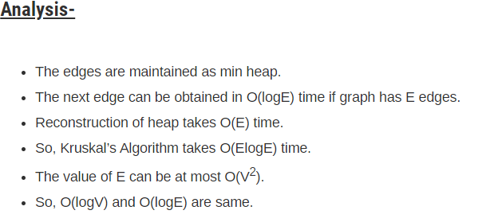
Real Time Application:
Landing Cables
TV Networks
Tour Operations

Slide 21
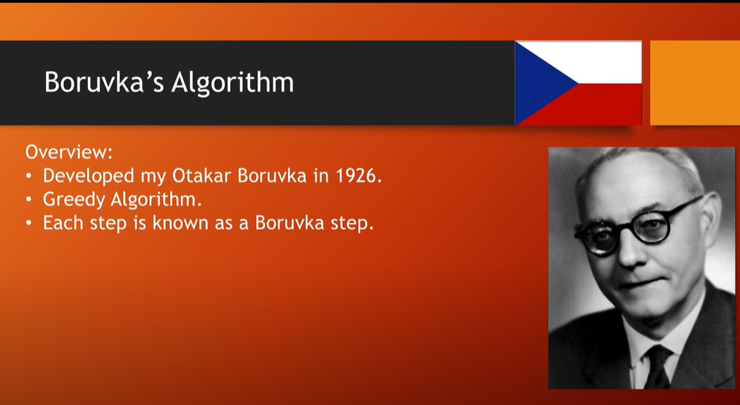
(Sollin’s Algorithm)

Slide 22
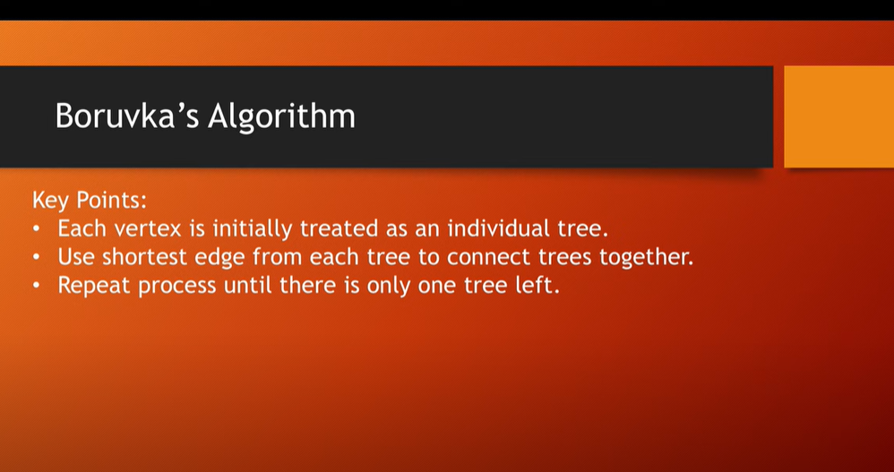

Slide 23
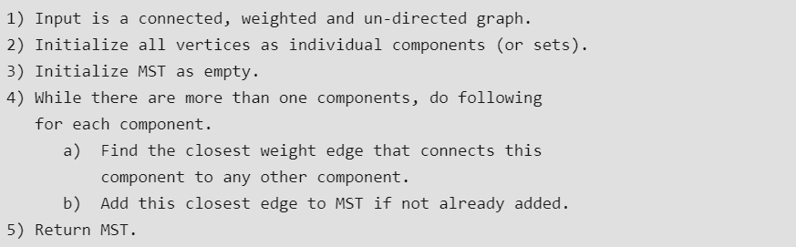
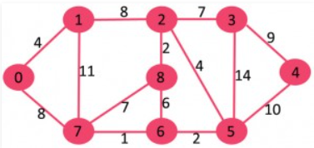

Slide 24
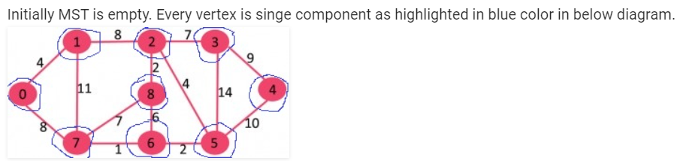
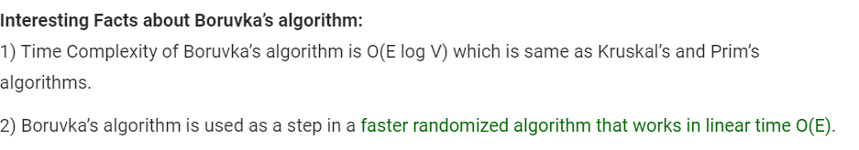
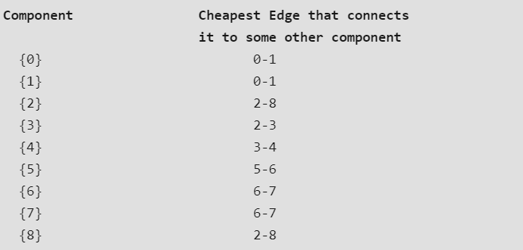
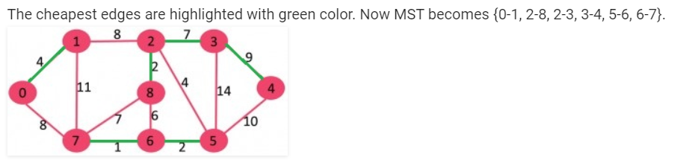

Slide 25
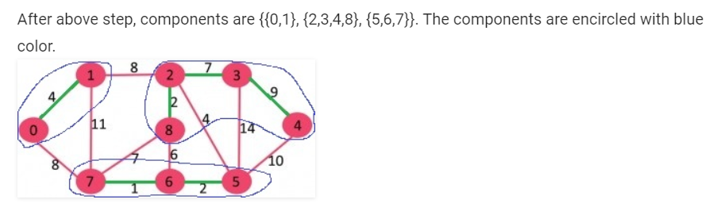





Slide 26
Dijkstra Algorithm’s – Shortest Path (OPTIMAL SOLUTION)
Dijkstra's algorithm is an algorithm for finding the shortest paths between nodes in a graph, which may represent, for example, road networks.
It was conceived by computer scientist Edsger W. Dijkstra in 1956 and published three years later.
The algorithm exists in many variants.
It works in both directed and undirected graph.
Also it may or may not works in non positive edge value.
Relaxation:
If(d[u] + c[u,v] <d[v])
d[v] = d[u] + c[u,v]
7
Cost
2
2
4
1
6
Starting Node
1
1
2
Distance
2
4
4
3
5
5
Node | U | V | D(v)
1 – 2 | 0 | 2 | 2
1 – 3 | 0 | 4 | 4
2 – 3 | 2 | 1 | 3
2 – 4 | 2 | 7 | 9
3 – 5 | 4 | 3 | 7
4 – 6 | 9 | 1 | 10
A
B
C
3

Slide 27

45
50
10
A
B
C
Starting Vertex is A
15
35
10
20
30
D
E
F
Selected Vertex | B | C | D | E | F
A | 50 | 45 | 10
D | 50 | 45 | 10 | 25
E | 45 = 25+20 | 45 | 10 | 25
B | 45 | 45 | 10 | 25
C | 45 | 45 | 10 | 25
15
3

Slide 28
Dijkstra Algorithm’s – Shortest Path (OPTIMAL SOLUTION)
Negative values may or may not work
Starting Vertex: A
3
A
B
5
-3
Selected Vertex | B | C | D
A | 3 | 5
B | 3 | 5
C | 3 | 5 | 8 = 5+3
D | 3 | 5 | 8
C
D
3

Slide 29

BELLMAN FORD – Single Source Shortest Path
Bellman Ford algorithm helps us find the shortest path from a vertex to all other vertices of a weighted graph.
It is similar to Dijkstra's algorithm but it can work with graphs in which edges can have negative weights
It is dynamic programming method

Slide 30




Slide 31





Slide 32





Slide 33




Slide 34





Slide 35





Slide 36


Slide 37

Floyd Warshall’s – All Pair Shortest Path
Floyd Warshall Algorithm is a famous algorithm.
It is used to solve All Pairs Shortest Path Problem.
It computes the shortest path between every pair of vertices of the given graph.
Floyd Warshall Algorithm is an example of dynamic programming approach.

Slide 38




Slide 39



For D1 Matrix
K | I | J
K=1 | I=1 | J=1,2,3,4
K=1 | I=2 | J=1,2,3,4
K=1 | I=3 | J=1,2,3,4
K=1 | I=4 | J=1,2,3,4
For D2 Matrix
K | I | J
K=2 | I=1 | J=1,2,3,4
K=2 | I=2 | J=1,2,3,4
K=2 | I=3 | J=1,2,3,4
K=2 | I=4 | J=1,2,3,4

Slide 40

For D3 Matrix
K | I | J
K=3 | I=1 | J=1,2,3,4
K=3 | I=2 | J=1,2,3,4
K=3 | I=3 | J=1,2,3,4
K=3 | I=4 | J=1,2,3,4
For D4 Matrix
K | I | J
K=4 | I=1 | J=1,2,3,4
K=4 | I=2 | J=1,2,3,4
K=4 | I=3 | J=1,2,3,4
K=4 | I=4 | J=1,2,3,4

Slide 41
Method | Complexity | Advantages | Disadvantages | Application
Prim’s | O(E + logV) | Better when dealing with dense graph | Difficult to program, though it can be programmed in matrix form. | Telephone, Cable network
Kruskal’s | O(ElogV) | Minimum Cost selection does not have any criteria | Works only in connected and weighted (non connected should not give a final MST) | Tour Operation, Landing Cables
Sollin’s | O(ElogV) | Better operation in parallel network | Not adapt to distributed network | Electrical Wiring social network like linkedin, Fb
Djikstra | O(n power 2) | Google Maps | Not able to handle negative edges | Routing protocols required by the routers to update their forwarding table
Bellman Ford | O(|E||V|) | Handle negative edges | Fails to handle undirected graphs when it comes to negative weights | Distance Vector routing
Floyd’s | O(n power 2 * n) | Extremely simple and Easy to implement | Slower than other algorithms designed to perform the same task | Fast Computation of Path finder

